Slide 1
Data-Driven Methods to Mitigate Asteroid Impact
Presented By Amber, Amie Katherine and Siobhan

Slide 2

Objective
Question: Can we train a model to identify hazardous asteroids?

Slide 3
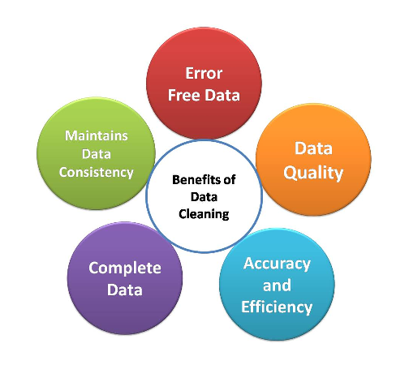
Ensuring Data Integrity

Slide 4
Dataset
We found our data source on Kaggle (https://www.kaggle.com/datasets/sakhawat18/asteroid-dataset/data ).
This data was originally from the Propulsion Laboratory of California Institute of Technology which is an organization under NASA ( NASA JPL Small Body Search Engine ).
The original dataset had 45 columns of data and close to one million rows of data.
We parsed that down to six columns for our final model.

Slide 5
Critical Data for Asteroid Identification
Our final dataframe identified six columns that were critical for identifying potentially hazardous asteroids:
NEO – Near Earth Object flag
H – Absolute magnitude parameter
Diameter – object diameter
Moid – Earth Minimum Orbit Intersection Distance
RMS – root mean square (error of the fit of the asteroid's orbit to the observed data)
Class – spectral class or type

Slide 6

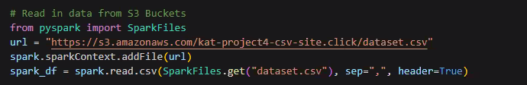
Data Management - AWS
Due to the size of the data set, we created an AWS site to house the data
AWS, or Amazon Web Services, is a comprehensive cloud computing platform provided by Amazon. It offers a wide range of services and tools that enable organizations to build and deploy various applications and services in the cloud

Slide 7
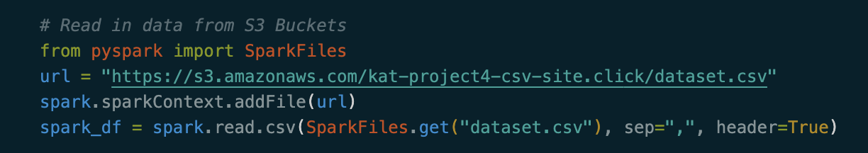
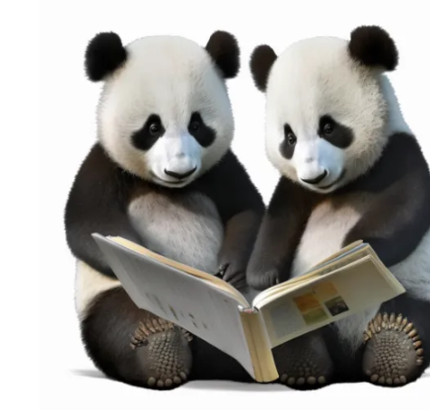
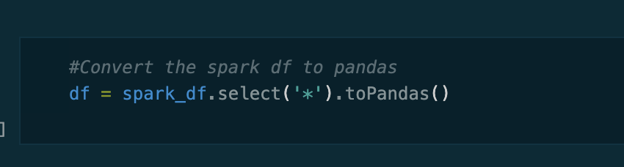
Data Conversion to Pandas
We used Spark to import our CSV file from AWS and create a Spark dataframe. Due to the size of the dataframe, we had to do some preprocessing of the data first.
Then, we used Arrow to convert the Spark dataframe to a Pandas dataframe to perform the rest of our analysis.

Slide 8
Preprocessing
We dropped some unnecessary columns (multiple id columns and name columns) which did not provide any information critical to our analysis.
We also dropped rows with null values in order to consolidate our data set to a little more than 100,000 rows.
All columns were converted back to the correct data type, as the Spark to Pandas conversion imported everything as an object.
Any columns with text values (NEO, PHA, Class) were encoded to numerical values.
Our final step was to remove PHA, split training/test datasets, and scale the training/test data.

Slide 9
Model 1
First Model Features:
Sequential model
36 inputs
2 layers with Relu activation
Last layer with sigmoid activation
Compiled with loss- binary crossentropy and optimized with adam
Epochs: 10
Loss: 0.01; Accuracy 99.86%
Model 1 achieved 99.86% accuracy:
The goal with subsequent models will see if we can achieve the same accuracy, with less data.

Slide 10
Model 2
Second Model Features:
Changes: “sigma” columns removed from dataset, fewer nodes per layer
Sequential model
24 inputs
2 layers with Relu activation
Last layer with sigmoid activation
Compiled with loss- binary crossentropy and optimized with adam
Epochs: 10
Loss: 0.01; Accuracy 99.86%
Optimization attempt 1:
The accuracy stayed consistent despite these changes

Slide 11
Model 3
Third Model Features:
Changes: All but 6 key feature columns removed from dataset, fewer nodes per layer
Sequential model
6 inputs
2 layers with Relu activation
Last layer with sigmoid activation
Compiled with loss- binary crossentropy and optimized with adam
Epochs: 10
Loss: 0.002; Accuracy 99.89%
Optimization attempt 2:
Accuracy increased to 99.89%.

Slide 12
Model 4
Fourth Model Features:
Changes: All but 3 key feature columns removed from dataset, fewer nodes per layer, 1 layer dropped
Sequential model
3 inputs
1 layer with Relu activation
Last layer with sigmoid activation
Compiled with loss- binary crossentropy and optimized with adam
Epochs: 10
Loss: 0.003; Accuracy 99.82%
Optimization attempt 3:
Removing moid, class, and rms did help determine which asteroids are hazardous and which are not. This was our least accurate model.

Slide 13
Model 5
Fifth Model Features:
Changes: Reverted data back to third model attempt columns, layers and nodes. Data was processes using these 6 columns resulting in more data to train with.
Sequential model
6 inputs
2 layer with Relu activation
Last layer with sigmoid activation
Compiled with loss- binary crossentropy and optimized with adam
Epochs: 10
Loss: 0.001; Accuracy 99.92%
Optimization attempt 4 (final)
Df3 gave us the most accurate Model. In this final attempt, we will recreate the df only using these columns and removing null values from these columns. This will ideally give us more data to train the model with. Accuracy was 99.92%.

Slide 14

Model Results
Our final model consisted of six columns (NEO,H,Diameter,Moid,RMS,Class). We dropped the null values to give us more data to train the model, and encoded the values for the PHA, NEO, and Class column as numbers.
The final accuracy score for our final model was 99.92%, increasing the accuracy of our first model (99.86%)

